Slide 1

Basic Details of the Team and Problem Statement
Ministry/Organization Name/Student Innovation: Ministry of Power
PS Code: SIH1389
Problem Statement Title: To develop centralized information security .Log-collection facility or security operation centre (soc) in the power sector, considering cEA cybersecurity (Power Sector) Guideliness, 2021 to keep Ir and or networking System isolated and air-gapped. Blockchain & Cybersecurity.
Team Name: Tech-Savvies
Team Leader Name: Harsh Thakur
Institute Code (AISHE): C-36022
Institute Name: Lakshmi Narayan College Of Technology
Theme Name: Blockchain and Cybersecurity

Slide 2
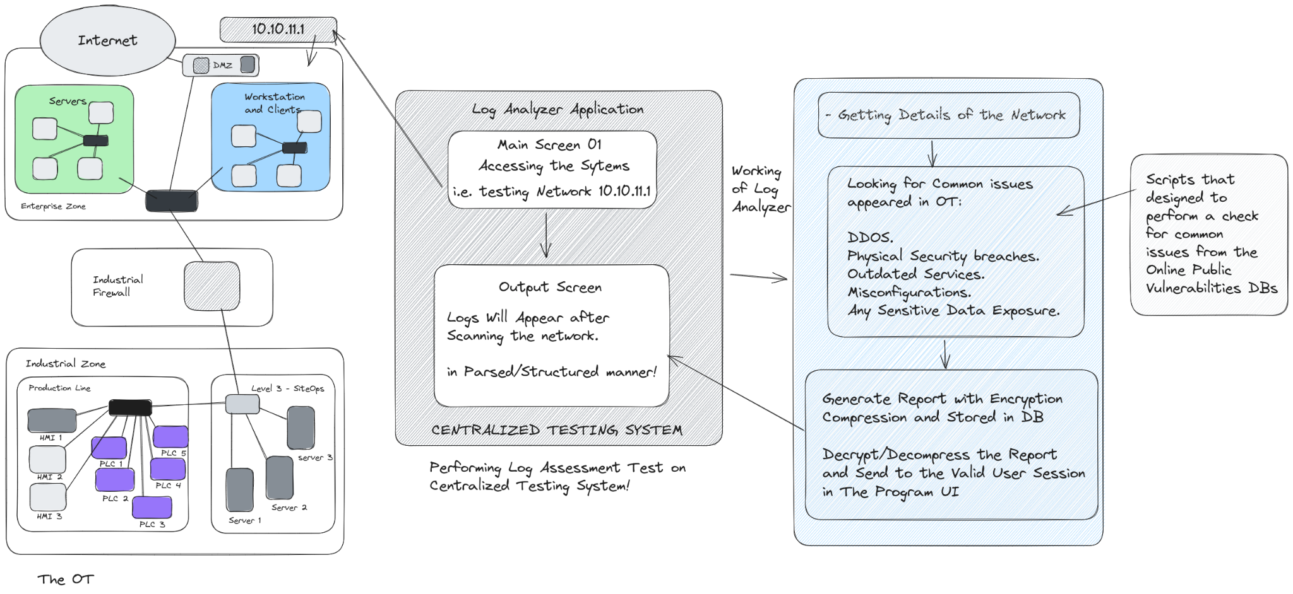
Idea/Approach Details
Describe your idea/Solution/Prototype here:
The Idea is create Log Analyzer Tool which helps us to collect the Log Information of a network and specifically look for any compromises that lead to OT(Operational Technology) exploitation.
Also the Log analyzer tool will provide you the general log information for many other common issues other than OT. (i.e. Other Services misconfiguration, Sensitive Data Exposure)
The Log Analyzer Tool uses the smart integration to check for the problems identified from the fetched logs. Mainly used popular Public Vulnerabilites DBs (exploitdb, nvd, osvdb, etc.)
The logs will be stored securely in the centralized system’s Database in the Encrypted and Compressed Form.
The Logs reports are customizable by the UI options presented in the Log Analyzer Application, also the by default a smart report will appear on the dashboard.
Describe your Technology stack here:
Python library for Fetching Vulnerable Application’s Information: pyExploitDb
Using HTML, CSS, Javascript for Web-UI
Python-Scripting for Parsing and Filtering Logs Data.
NoSQL Database for Storing Encrypted and Compressed Logs Information.
Online Tools Integration (ipinfo, shodan, various OSINT tools)

Slide 3
Idea/Approach Details
Describe your Use Cases here
Describe your Dependencies / Show stopper here
The Log analyzer tools useful for checking the common flaws in the infrastructure network
It also helps you to monitor the status of the services and helps in any optimal changes that can be done.
Keeps you updated with the Security and helps you to keep a track of all activities happened in the infrastructure working hours.
You can have the backup of all logs for professional conveniency.
Helps you in the Smart Study of all tech stack connected in the network, of which information is appeared in the logs.
The assessment of logs will provide you precaution for avoiding any potential threat and breach in the OT or any network system.
Platform Independent: Can be easily setup on any OS (Windows, Linux or Mac)
Required Applications: Python, Browser, Web-Server (apache, xampp for windows)

Slide 4
Team Member Details
Team Leader Name : Type Your Name Here : Harsh thakur
Course –B.Tech Branch - CSE - AIML Year - II
Team Member 1 Name : Type Your Name Here : Durin Lalwani
Course –B.Tech Branch - CSE - AIML Year - II
Team Member 2 Name : Type Your Name Here : Aniket Patel
Course –B.Tech Branch - CSE - AIML Year - II
Team Member 3 Name : Type Your Name Here : Nikhita Das
Course –B.Tech Branch - CSE - AIML Year - II
Team Member 4 Name : Type Your Name Here : Kratika Yadav
Course –B.Tech Branch - CSE - AIML Year - II
Team Member 5 Name : Type Your Name Here : Nikhil Prasad
Course –B.Tech Branch - CSE - AIML Year - II
Team Mentor 1 Name :

Slide 5
Important Pointers
Please ensure below pointers are met while
Kindly keep the maximum slides limit to 4 pages
All the topics should be utilized for description of your idea
Try to avoid paragraphs and post your idea in points
Keep your explanation precisely and easy to understand
Idea should be unique and novel. If it has a business potential more weightage will be given.
Apart from this PPT abstract of your idea will be asked separately while submitting
You need to save the file in PDF and upload the same on portal. No PPT, Word Doc or any other format will be supported
You can delete this slide (Important Pointers) when you upload the details of your idea on SIH portal.

